Slide 1
lecture 6 Parts Design Choices(part2)

Slide 2
Motor/Encoder

Slide 3
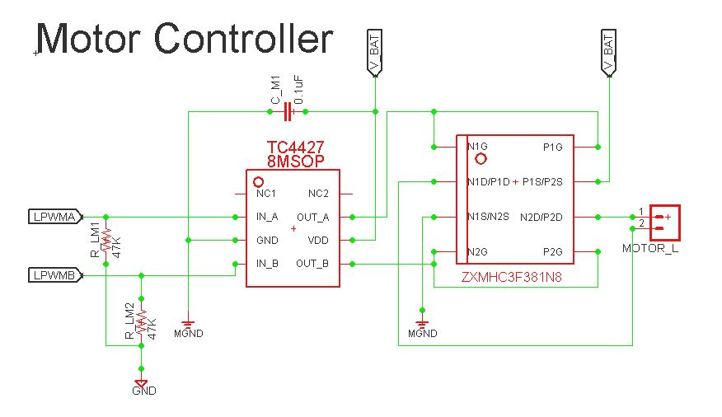
P/N mosfet type w/ level shifter Motor driver

Slide 4
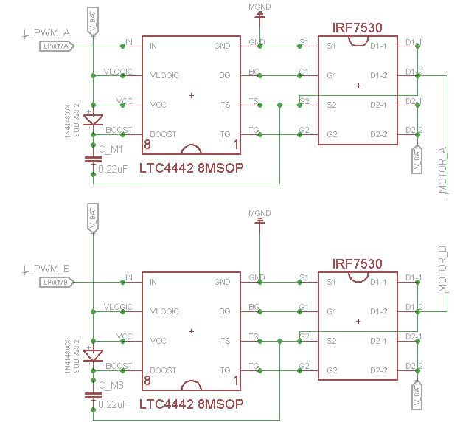
N/N mosfet type half H-bridge w/ boost converter level shifter

Slide 5
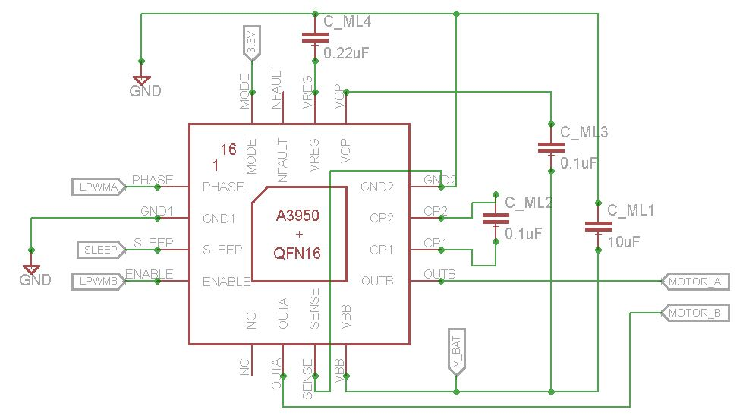
N/N mosfet type All-In-One motor driver

Slide 6
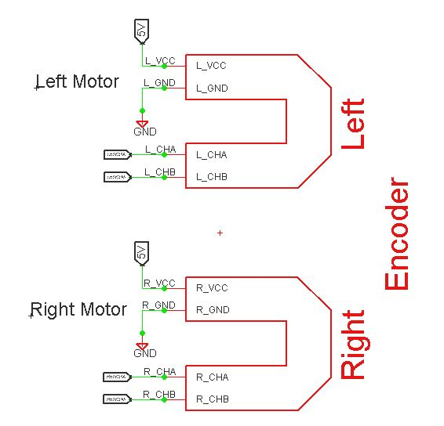
Encoder
Provided with eagle library for kitmouse
Either 3.3V-5V supply

Slide 7
User Interface

Slide 8
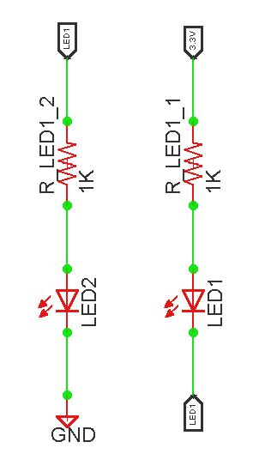
LED
2 ways to control LED with MCU
The one on left is easier for wiring since ground is easier to find
The way to the right is better MCU since it doesn’t draw power from MCU

Slide 9
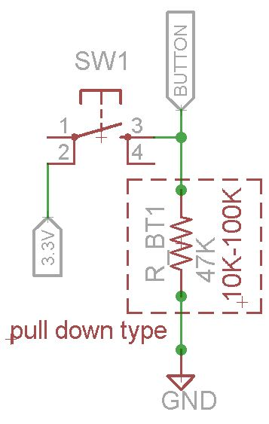
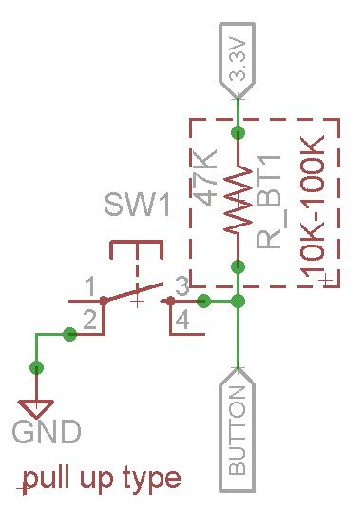
button

Slide 10
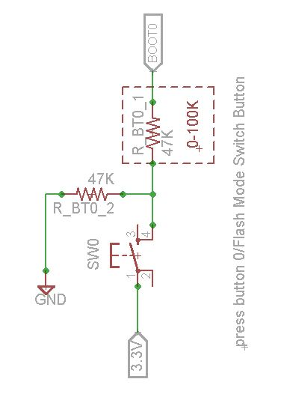
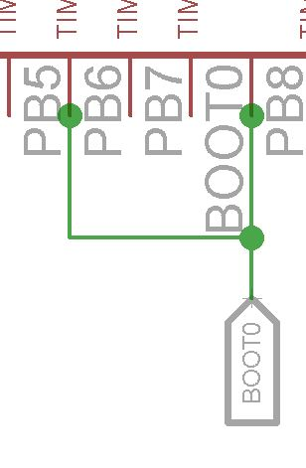
Button Shared with Boot0
To save one more button

Slide 11
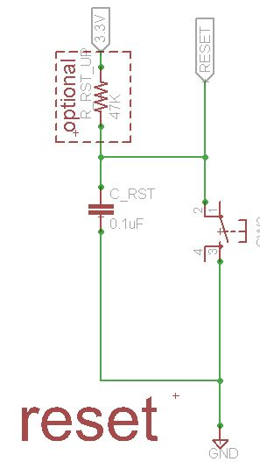
Reset Button
Reset instead of re-power
Helpful for Bluetooth, no re-pair needed is just reset instead of power it off and on

Slide 12
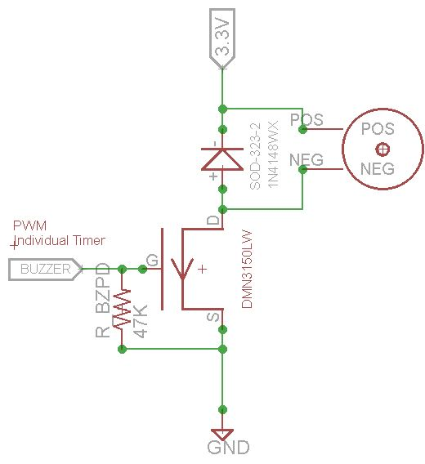
Buzzer
PWM Driven
Optional diode to prevent kick-back current from buzzer
Must be magnetic buzzer(w/polarities)

Slide 13
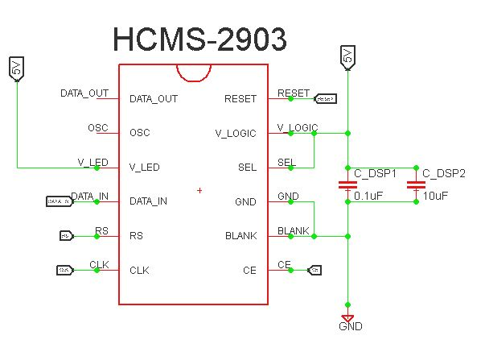
Display
Optional
Costly but takes less time than serial print
Real time date output

Slide 14
Device

Slide 15
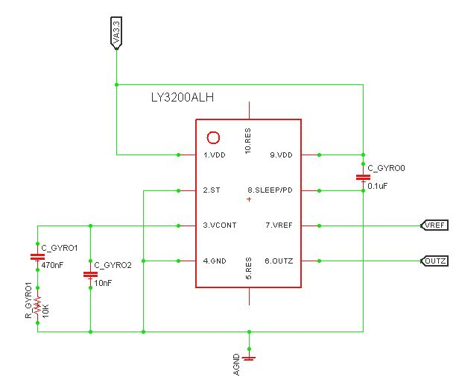
Gyro
Power sensitive, make clean power and ground
Doesn’t have to place in the middle of mouse

Slide 16
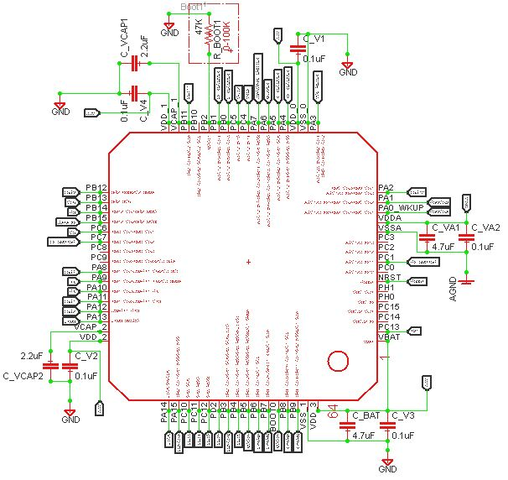
MCU
We use STM32F405RG as MCU
All VCAP and VDD VSS should connect as what indicated here
Boot0/boot1/reset should be connected as well
Connect programmer and USART port

Slide 17
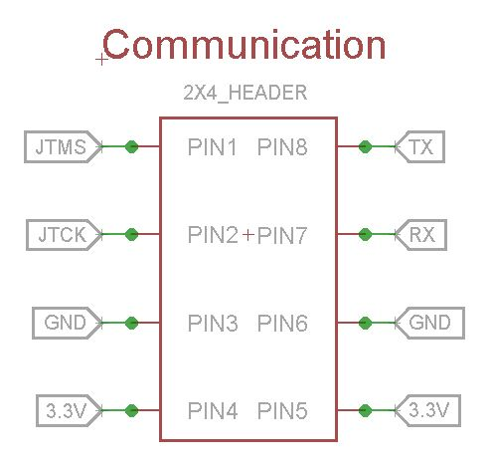
Communication Port
Basic 8 pin config
Need 3.3V for USART side for Bluetooth Power
Follow the pin order in picture in order to compatible with existing gadgets we have

Slide 18
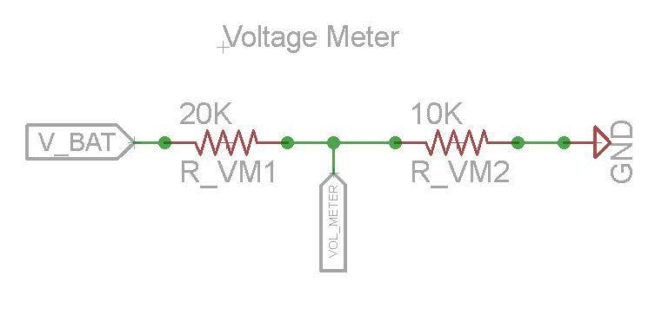
Voltage Meter
Need to detect battery voltage in order to protect battery
Choose resistor wisely to prevent ADC reading saturation
Resistor supposed to be K level

